Slide 1
COMP4332/RMBI4310 Big Data Mining and Management Advanced Data Mining for Risk Management and Business Intelligence (2025 Spring)
Tutorial 1: CF-based Recommendation
TA: Hong Ting TSANG (httsangaj@connect.ust.hk)

Slide 2
Packages to Install in This Tutorial
Pandas
Numpy
Scikit-learn
You can install them by simply running the following commands:
conda install pandas
conda install scikit-learn
conda install numpy

Slide 3
Recommendation System
Collaborative Filtering based Recommendation
User-based
Item-based
Matrix Factorization
SVD-based Recommendation

Slide 4
User CF/Item CF

Slide 5
User CF

Slide 6
User CF
𝑆(𝑢, 𝐾): Top K similar users
𝑁(𝑖): Users who like item 𝑖
𝑤_{uv}: Similarity of u and v
𝑟_{vi}: 1 at most time

Slide 7
Item CF

Slide 8
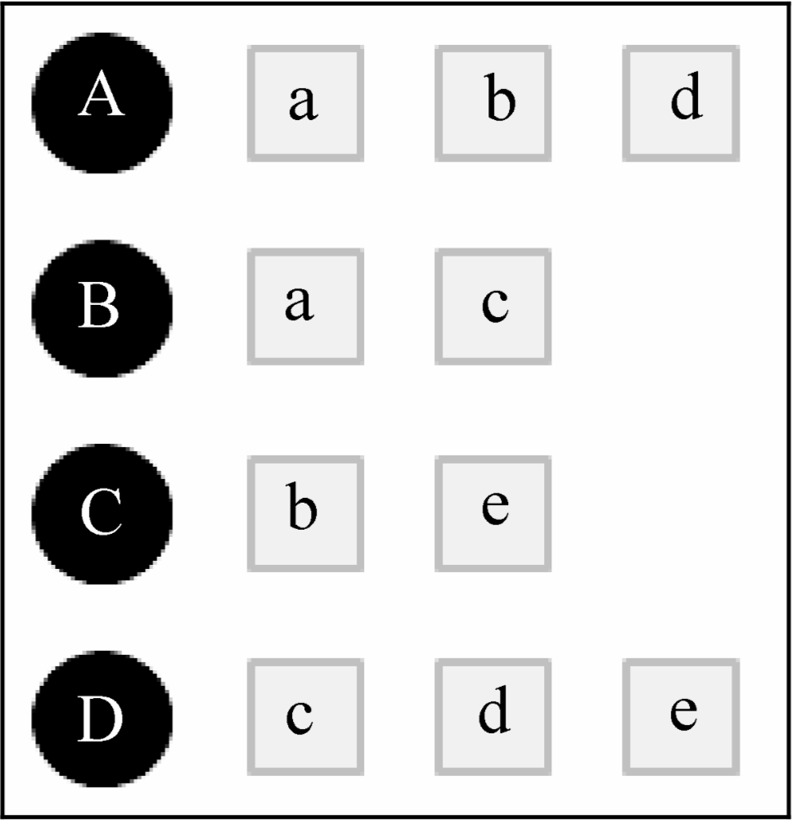
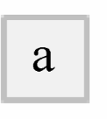




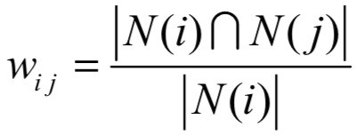





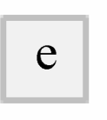
Item CF

Slide 9
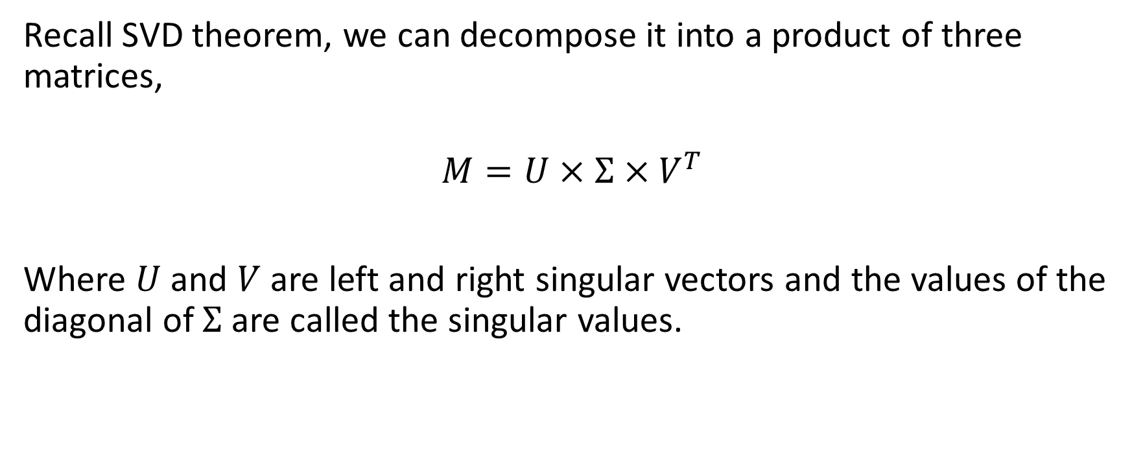
SVD-based Recommendation
Recall SVD theorem, we can decompose it into a product of three matrices,
$$M=U×Σ×V^{T}$$
Where $U$ and $V$ are left and right singular vectors and the values of the diagonal of $Σ$are called the singular values.

Slide 10
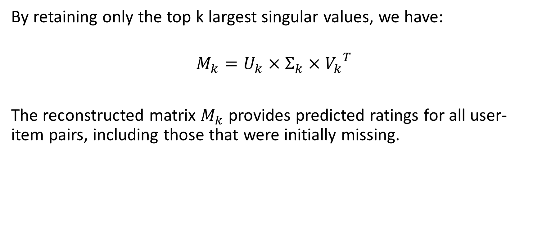
SVD-based Recommendation
By retaining only the top k largest singular values, we have:
$$M_{k}=U_{k}×Σ_{k}×{V_{k}}^{T}$$
The reconstructed matrix $M_{k}$ provides predicted ratings for all user-item pairs, including those that were initially missing.

Slide 11

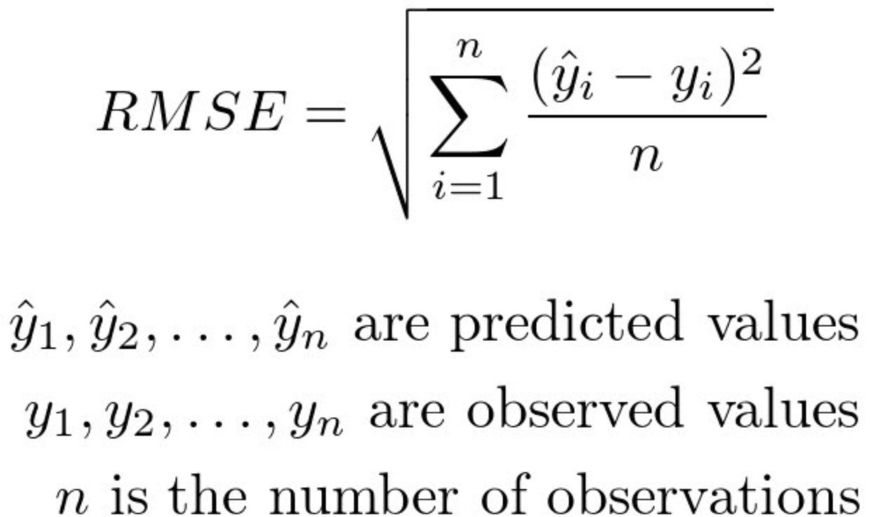
Rating Prediction
Predict users’ ratings on items given some known ratings. The prediction would be evaluated by Root Mean Squared Error (RMSE)

Slide 12
Implementation of the Rating Prediction Task
See the Jupyter Notebook.

